Slide 1





Instructional Design
for Lesson on Antibiotic Resistance
Presenter: Shayla Nelson
Notes:
Hello everyone. Welcome to my ID presentation. Before I jump in, I wanted to provide a brief explanation. So, a little-known fact about me is that I used to be an applied health major and certificates in public health and epidemiology. My bachelor's degree is Statistics, but I did the Biostatistics track so I took a lot of biology classes as well. Anyway, I wanted to throw it back and explore something I haven't done in awhile since I'm not actually a teacher or ID. So, I didn't feel like I needed to do anything applicable. So here you go. An ID for a lesson on Antibiotic Resistance.

Slide 2

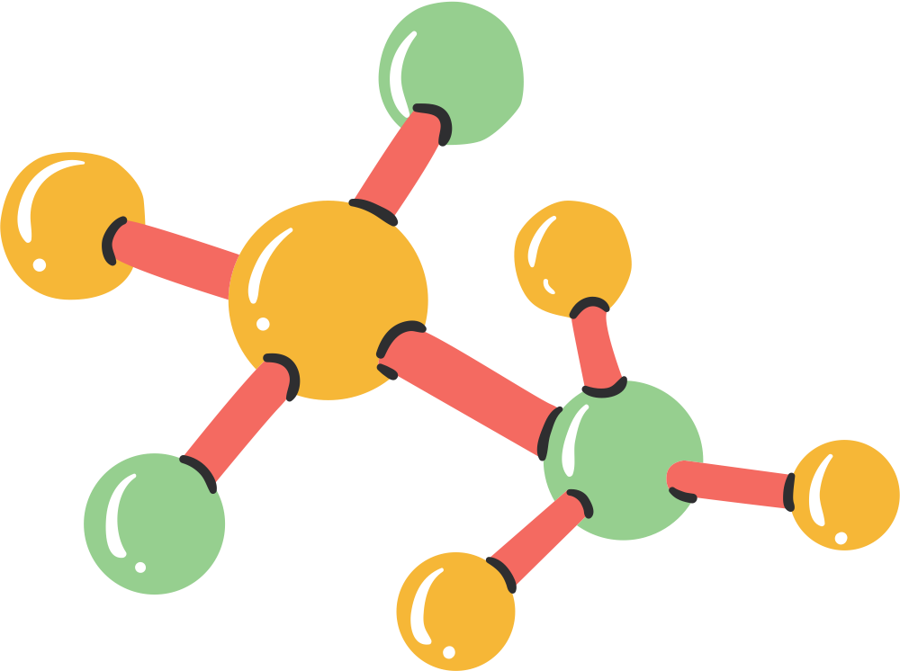


Introduction
to Instructional Design for Antibiotic Resistance Lesson
What
Why
Who
A critical global health issue threatening the effectiveness of antibiotics
To educate a broad audience about resistance mechanisms, consequences, and solutions
Primary audience: Undergraduate and graduate STEM students
Secondary audience: General public, healthcare practitioners, and educators

Slide 3



Learner Analysis
Primary Audience
Undergraduate and graduate STEM students
Secondary Audience
General public, healthcare practitioners,
and educators
Common Traits
Motivation for Participation
Familiarity with antibiotics, desire to understand resistance, driven to address real-world issues
Academic and professional goals, desire for awareness and informed decision-making
Differences Among Learners
Instructional and Non-Instructional Needs
Varying academic focus, technical background, learning goals, and range of ability
Access to digital tools, tailored materials, flexible delivery formats, adequate time, support from others, and clear communication

Slide 4

Needs Analysis
Instructional Problems and Learner Needs
Instructional Problems:
Lack of foundational knowledge
Insufficient data interpretation skills
Disconnection from real-world contexts
Learner Needs:
Cognitive: Understanding resistance mechanisms
Affective: Motivation through relevance
Technical: Access to digital tools

Slide 5
Task Analysis
Goal: Enable learners to analyze resistance mechanisms, understand implications, propose strategies
Task List
1. Understand basics of antibiotics and resistance
4. Interpret data on resistant strains
2. Identify mechanisms of resistance
5. Propose strategies to combat resistance
3. Analyze global implications
6. Communicate findings and recommendations

Slide 6
Terminal/Enabling Objectives
Module 1: Introduction to Antibiotics and Resistance
Terminal Objective
Enabling Objectives
Learners will explain the role of antibiotics and describe the basic mechanisms by which bacteria develop resistance
Define antibiotics and describe their role
Explain how bacteria develop resistance

Slide 7
Terminal/Enabling Objectives
Module 2: Mechanisms of Resistance
Terminal Objective
Enabling Objectives
Learners will identify and describe the major mechanisms of antibiotic resistance in bacteria
Explain degradation of antibiotics
Recognize and describe resistance mechanisms

Slide 8
Terminal/Enabling Objectives
Module 3: Analyzing Data on Resistance
Terminal Objective
Enabling Objectives
Learners will analyze data to identify patterns of antibiotic resistance
Recognize and interpret patterns and trends in charts and graphs
Analyze and summarize key takeaways from visual data

Slide 9
Terminal/Enabling Objectives
Module 4: Global and Healthcare Implications
Terminal Objective
Enabling Objectives
Learners will evaluate the global and healthcare implications of antibiotic resistance
Analyze and discuss case studies and their healthcare impacts
Identify and evaluate and economic, societal, personal, and/or community-level risks

Slide 10
Terminal/Enabling Objectives
Module 5: Strategies to Combat Resistance
Terminal Objective
Enabling Objectives
Learners will propose strategies to mitigate antibiotic resistance in healthcare and community settings
Identify actionable steps and evaluate effectiveness of strategies
Explore innovative solutions and advocate for community actions

Slide 11
Terminal/Enabling Objectives
Module 6: Communicating Findings and Proposing Actions
Terminal Objective
Enabling Objectives
Learners will summarize insights on antibiotic resistance and present actionable
Create a report or infographic summarizing findings
Communicate action plans

Slide 12


Assessment
Module 1: Quizzes, interactive activities
Module 2: Case studies, multiple-choice questions
Module 3: Data analysis, comprehension questions
Module 4: Essays, group discussions
Module 5: Action plans, facilitated conversations
Module 6: Presentations, reflective infographics

Slide 13


Nine Events of Instruction
Event 1: Gaining Attention
*Event 4: Presenting the Stimulus Material
Event 7: Providing Feedback About Performance Correctness
Real-world scenario video clip
Immediate, constructive feedback
Structured modules
Event 2: Informing Learners of Objectives
Event 5: Providing Learning Guidance
Event 8: Assessing the Performance
Clear objectives for each audience
Interactive simulations, instructor support
Task-based assessments
Event 3: Stimulating Recall of Prior Learning
Event 6: Eliciting the Performance
Event 9: Enhancing Retention and Transfer
Quizzes, brainstorming activities
Real-world scenarios, post-training resources
Hands-on activities
*Event 4, "Presenting the Stimulus Material," involves addressing the terminal and enabling objectives through the instructional modules introduced on slides 6–11

Slide 14

Evaluation
Formative Evaluation:
Expert review
One-to-one evaluation
Small group evaluation
Field test
Summative Evaluation:
Learner mastery
Feedback and satisfaction surveys
Long-term skill application review
Impact on institutional and societal goals

Slide 15
Conclusion
to Instructional Design for Antibiotic Resistance Lesson
Summary
Impact
Next Steps
Addressing antibiotic resistance through targeted education
Preparing learners to tackle global health challenges
Implementing and refining the instructional module

Slide 16
Thank you!

